Slide 1

presented By Ashutosh rawat
Insurance Data Dataset Analysis

Slide 2
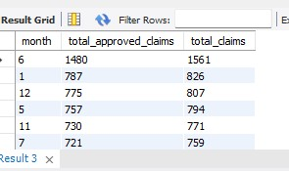


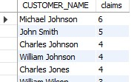
SQL Data Assessment
Analysis 1
Finding the loan approval and denied related
data .
1. Total claims made and claims approved per month
Answer :- Gives us the total claims applied and those approved in each month
2) Percentage of loan approved
Answer :- Gives what was the percentage of loan that were approved .
3) Percentage of loan denied
Answer :- Gives the percentage of loan denied
4) People applied for loan more than once and are approved
Answer :- Finding the no of people who have claimed for loan more than once to determine if there is
any discrepancy going in the process.

Slide 3
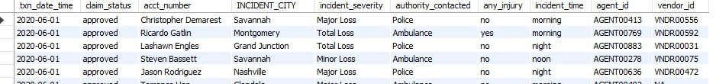
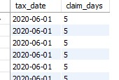
Analysis 2 : Criteria basis for approval and denial of claim
1) All details related to the loan approved
Answer :- Finding the details related to all the customers and the conditions that make up the approval criteria of claims.
2) Time taken for claim approval
Answer :- The time between the report date and the loss date for finding time for process and approval of claim.

Slide 4
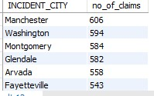
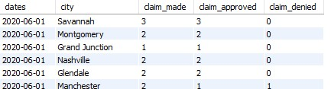
Analysis 3 : Claim Analysis as per each city
1) No of insurance claims per city
Answer :- This is the data to find claims to get how many claims are there filed in each city.
2) Claims approved and denied per city and date
Answer :- This gives in each date how many claims were made how many were approved and how many were denied in each city.

Slide 5
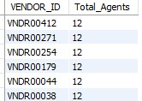
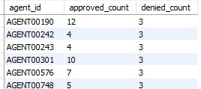
Analysis 4: Data related to agent and vendor.
1)Agent and vendor relationship.
Answer :- Finding how many agents are associated with each of the claim distributing vendor.
2) Claims associated with each agent.
Answer :- Claims approved and denied with each agent id.

Slide 6
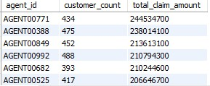
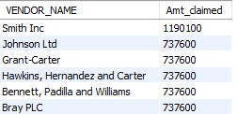
3) Top 10 performing agents.
Answer :- These are the agents who have succeeded to claim highest amount for their clients.
4) Top 10 performing vendors
Answer :- These are the top 10 vendors who have dispensed the highest amt of money.

Slide 7
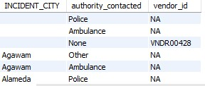
Analysis 5 : Data related to agent and vendor.
There are some issues related to data when loans are approved there are some of the details that are missing
so we will throw some light on those data.

Slide 8
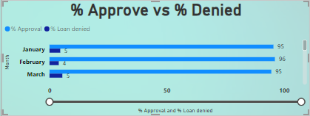
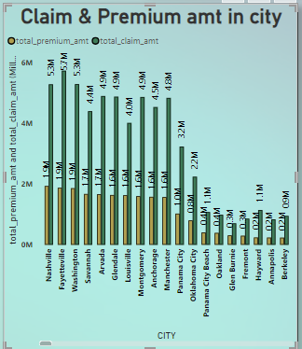
Power bi assignment
Visualize the yearly approval trends of claims .
Highlight any significant patterns and/or fluctuations,
if any.
Answer:- There is no big change in the approval or denial of
Claims.
2) Amount claimed and premium paid in each city
There is a large difference between the amount claimed and
premium paid by the customers in each and every city which
should be looked upon and along with this the factor associated
With this should be enquired.

Slide 9
Thank you
Final suggestions:-
1. We should take a look on customers who have applied for the same loan more than once.
2. The amount that dispersed and the premium amt paid for the loan should also be looked over
When the vendors are dispensing the claim amount a thoroughly inspections should be made as the loans that are approved have some essential details missing such as
For some claims the incident city name is missing , the vendor name is missing and for some the authority contacted is not present.

